Slide 1
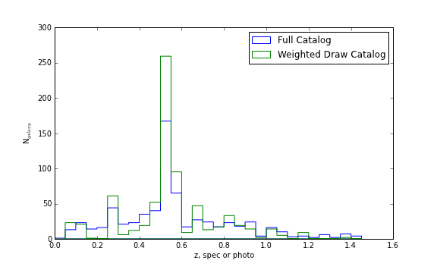
N_{galaxy}
Redshift (spectroscopic if available, otherwise photometric)

